Slide 2


Chapter 3: Digital Logic Structure
Peyman Pahlevani

Slide 3
Transistor: Building Block of Computers
Microprocessors contain millions of transistors
Intel Pentium 4 (2000): 48 million
IBM PowerPC 750FX (2002): 38 million
IBM/Apple PowerPC G5 (2003): 58 million
Logically, each transistor acts as a switch
Combined to implement logic functions
AND, OR, NOT
Combined to build higher-level structures
Adder, multiplexer, decoder, register, …
Combined to build processor
LC-3
Notes:
Intel and Pentium are trademarks of Intel Corporation. IBM and PowerPC are trademarks of International Business Machines Corporation. Apple is a trademark of Apple Computer, Inc.

Slide 4
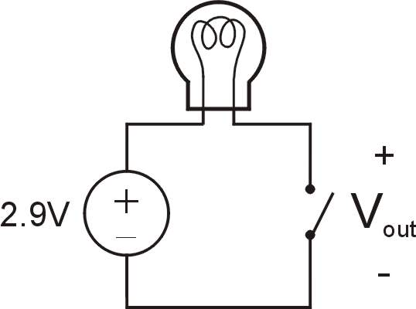
Simple Switch Circuit
Switch open:
No current through circuit
Light is off
V_{out} is +2.9V
Switch closed:
Short circuit across switch
Current flows
Light is on
V_{out} is 0V
Switch-based circuits can easily represent two states:
on/off, open/closed, voltage/no voltage.

Slide 5
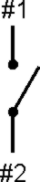
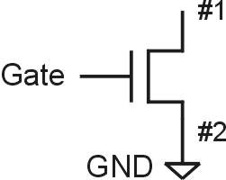
n-type MOS Transistor
MOS = Metal Oxide Semiconductor
two types: n-type and p-type
n-type
when Gate has positive voltage, short circuit between #1 and #2 (switch closed)
when Gate has zero voltage, open circuit between #1 and #2 (switch open)
Gate = 1
Gate = 0
Terminal #2 must be
connected to GND (0V).

Slide 6
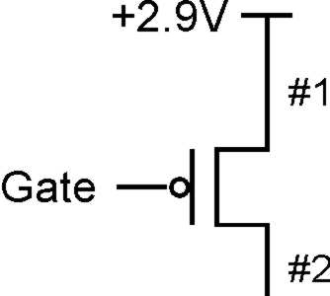
p-type MOS Transistor
p-type is complementary to n-type
when Gate has positive voltage, open circuit between #1 and #2 (switch open)
when Gate has zero voltage, short circuit between #1 and #2 (switch closed)
Gate = 1
Gate = 0
Terminal #1 must be
connected to +2.9V.

Slide 7
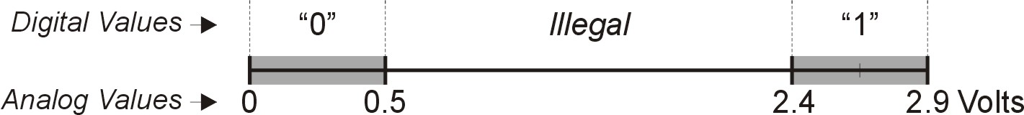
Logic Gates
Use switch behavior of MOS transistors to implement logical functions: AND, OR, NOT.
Digital symbols:
recall that we assign a range of analog voltages to each digital (logic) symbol
assignment of voltage ranges depends on electrical properties of transistors being used
typical values for "1": +5V, +3.3V, +2.9V
from now on we'll use +2.9V

Slide 8
CMOS Circuit
Complementary MOS
Uses both n-type and p-type MOS transistors
p-type
Attached to + voltage
Pulls output voltage UP when input is zero
n-type
Attached to GND
Pulls output voltage DOWN when input is one
For all inputs, make sure that output is either connected to GND or to +, but not both!

Slide 9
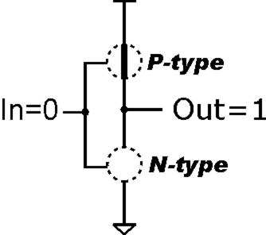
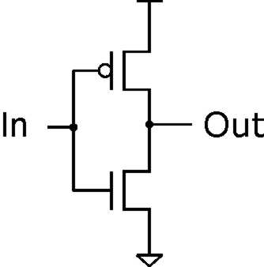
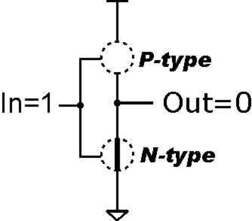
Inverter (NOT Gate)
Truth table
In | Out
0 V | 2.9 V
2.9 V | 0 V
In | Out
0 | 1
1 | 0

Slide 10
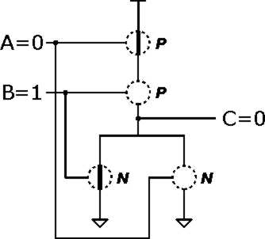
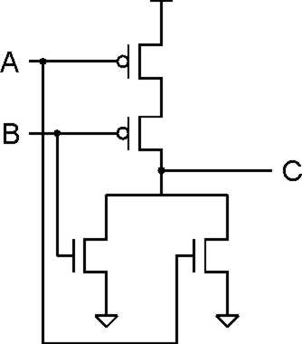
NOR Gate
Note: Serial structure on top, parallel on bottom.

Slide 11
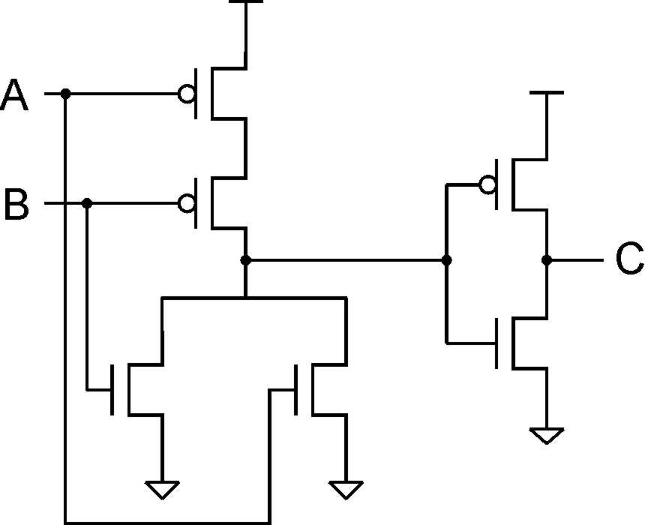
OR Gate
A | B | C
0 | 0 | 0
0 | 1 | 1
1 | 0 | 1
1 | 1 | 1
Add inverter to NOR.

Slide 12
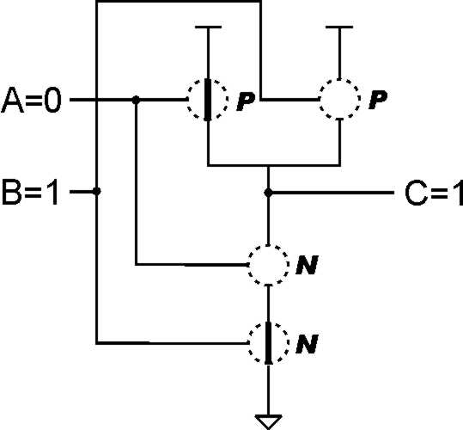
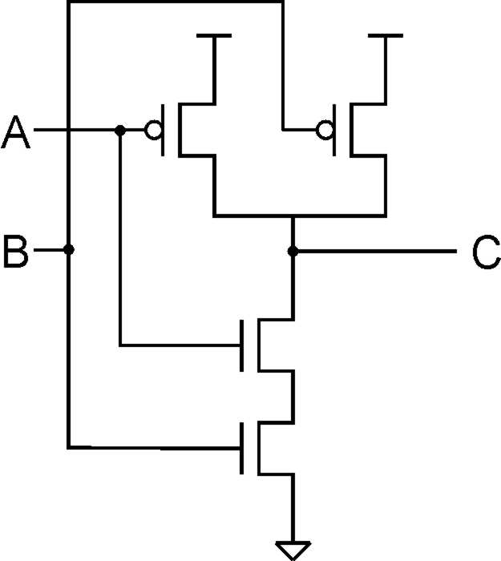
NAND Gate (AND-NOT)
A | B | C
0 | 0 | 1
0 | 1 | 1
1 | 0 | 1
1 | 1 | 0
Note: Parallel structure on top, serial on bottom.

Slide 13
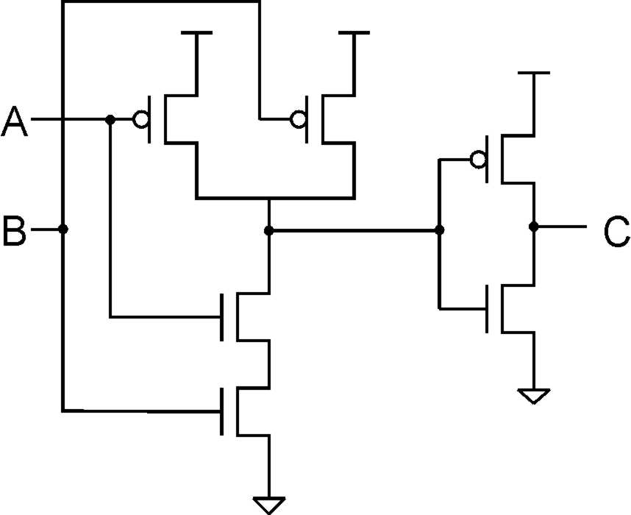
AND Gate
A | B | C
0 | 0 | 0
0 | 1 | 0
1 | 0 | 0
1 | 1 | 1
Add inverter to NAND.

Slide 14
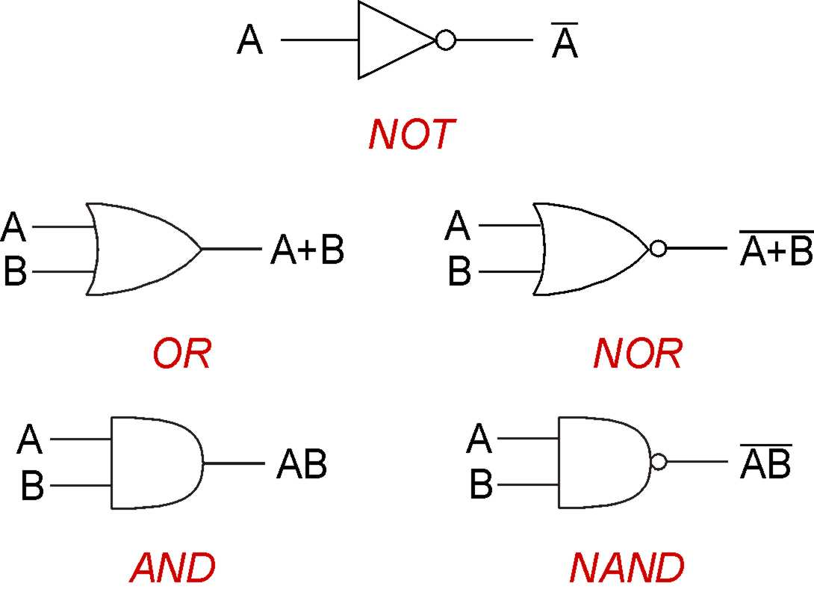
Basic Logic Gates

Slide 15
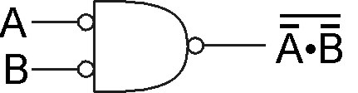
DeMorgan's Law
Converting AND to OR (with some help from NOT)
Consider the following gate:
To convert AND to OR
(or vice versa),
invert inputs and output.
A | B
0 | 0 | 1 | 1 | 1 | 0
0 | 1 | 1 | 0 | 0 | 1
1 | 0 | 0 | 1 | 0 | 1
1 | 1 | 0 | 0 | 0 | 1
Same as A+B!
Notes:
If there's time, perhaps discuss how all gates can be implemented with NAND (or NOR).
Therefore, you can implement any truth table using only NAND (or NOR) gates.

Slide 16
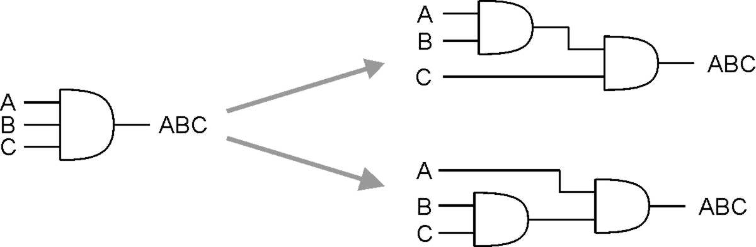
More than 2 Inputs?
AND/OR can take any number of inputs.
AND = 1 if all inputs are 1.
OR = 1 if any input is 1.
Similar for NAND/NOR.
Can implement with multiple two-input gates, or with single CMOS circuit.
Notes:
NAND and NOR are not associative.
Jim Conrad’s example:
NAND(NAND(0,0), 1) = NAND(1, 1) = 0
NAND(0, NAND(0,1)) = NAND(0, 0) = 1

Slide 17
Summary
MOS transistors are used as switches to implement logic functions.
n-type: connect to GND, turn on (with 1) to pull down to 0
p-type: connect to +2.9V, turn on (with 0) to pull up to 1
Basic gates: NOT, NOR, NAND
Logic functions are usually expressed with AND, OR, and NOT
DeMorgan's Law
Convert AND to OR (and vice versa) by inverting inputs and output

Slide 18
Building Functions from Logic Gates
Combinational Logic Circuit
output depends only on the current inputs
stateless
Sequential Logic Circuit
output depends on the sequence of inputs (past and present)
stores information (state) from past inputs
We'll first look at some useful combinational circuits, then show how to use sequential circuits to store information.

Slide 19
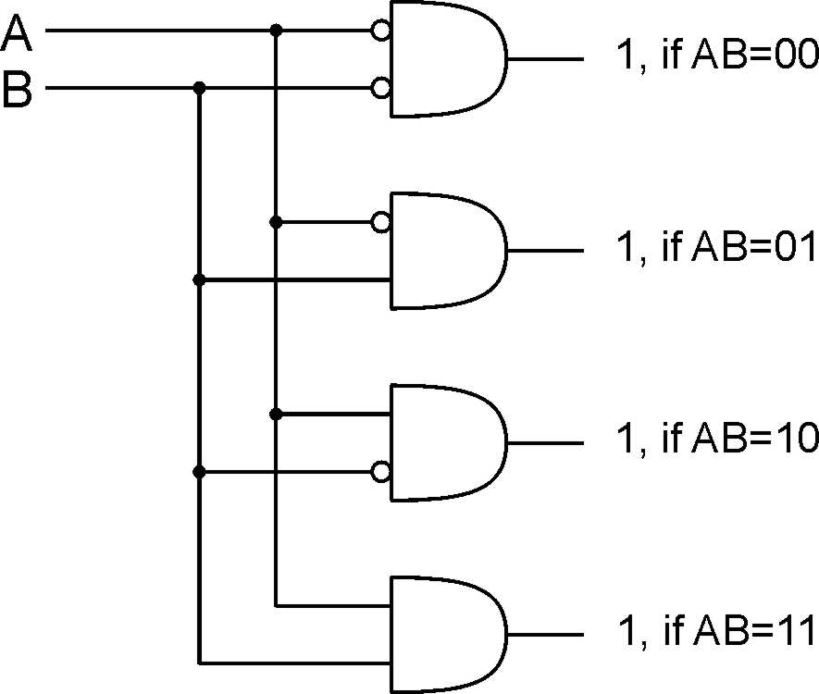
Decoder
n inputs, 2^{n} outputs
exactly one output is 1 for each possible input pattern
2-bit
decoder
Notes:
Uses of decoder:
convert memory/register address to a control line that selects that location
convert an opcode to one of n control lines

Slide 20
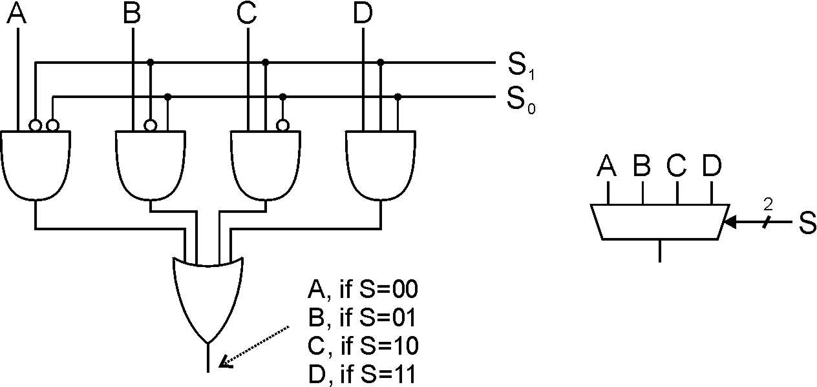
Multiplexer (MUX)
n-bit selector and 2^{n} inputs, one output
output equals one of the inputs, depending on selector
4-to-1 MUX
Notes:
Another view: decode S, and AND each output with one of the MUX inputs.
Also explain multi-bit inputs.
Uses of multiplexer:
select which input to use for function
select which computed value to pass to next stage (or to place on bus)

Slide 21
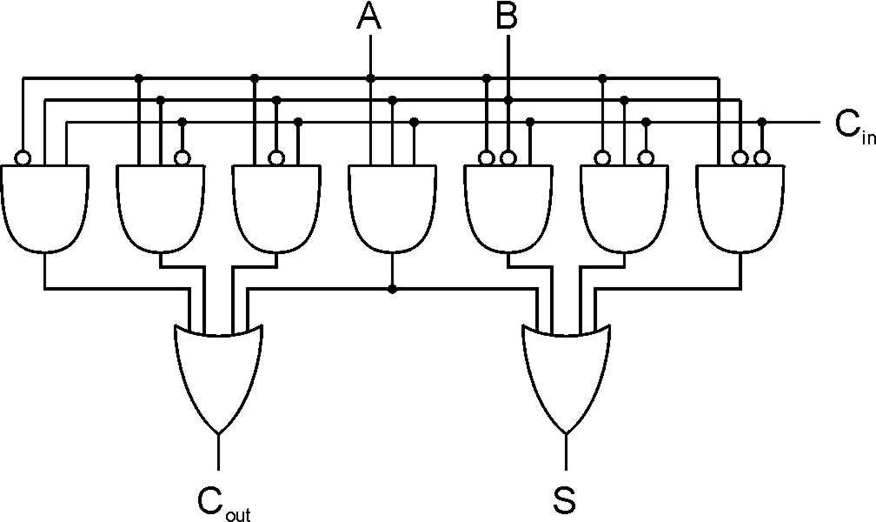
Full Adder
Add two bits and carry-in, produce one-bit sum and carry-out.
A | B | C_{in} | S | C_{out}
0 | 0 | 0 | 0 | 0
0 | 0 | 1 | 1 | 0
0 | 1 | 0 | 1 | 0
0 | 1 | 1 | 0 | 1
1 | 0 | 0 | 1 | 0
1 | 0 | 1 | 0 | 1
1 | 1 | 0 | 0 | 1
1 | 1 | 1 | 1 | 1
Notes:
A half-adder is one that doesn't take a carry-in.
Sum is one when 1 or 3 inputs are one. Carry-out is one when 2 or 3 inputs are one.

Slide 22
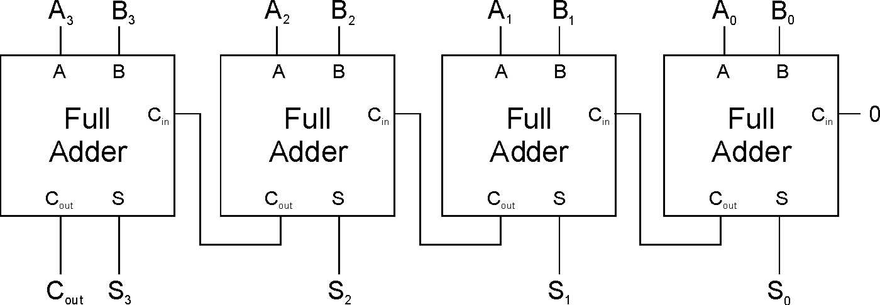
Four-bit Adder
Notes:
This is called a "ripple-carry" adder. The sum becomes valid as the carry ripples its way from the low bit to the high bit. How many gate delays until the output is settled?

Slide 23
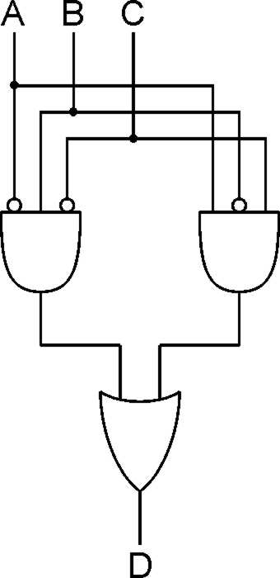
Logical Completeness
Can implement ANY truth table with AND, OR, NOT.
A | B | C | D
0 | 0 | 0 | 0
0 | 0 | 1 | 0
0 | 1 | 0 | 1
0 | 1 | 1 | 0
1 | 0 | 0 | 0
1 | 0 | 1 | 1
1 | 1 | 0 | 0
1 | 1 | 1 | 0
1. AND combinations that yield a "1" in the truth table.
2. OR the results of the AND gates.
Notes:
Note the use of the bubbles (NOT) in the input.

Slide 24
Combinational vs. Sequential
Combinational Circuit
always gives the same output for a given set of inputs
ex: adder always generates sum and carry, regardless of previous inputs
Sequential Circuit
stores information
output depends on stored information (state) plus input
so a given input might produce different outputs, depending on the stored information
example: ticket counter
advances when you push the button
output depends on previous state
useful for building “memory” elements and “state machines”

Slide 25
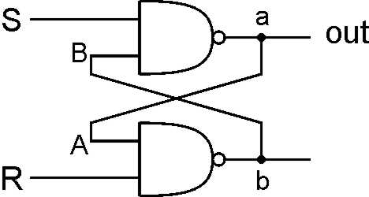
R-S Latch: Simple Storage Element
R is used to “reset” or “clear” the element – set it to zero.
S is used to “set” the element – set it to one.
If both R and S are one, out could be either zero or one.
“quiescent” state -- holds its previous value
note: if a is 1, b is 0, and vice versa
1
1
0
1
1
0
1
1
0
0
1
0
1
1

Slide 26
Clearing the R-S latch
1
Suppose we start with output = 1, then change R to zero.
0
1
1
1
0
0
Output changes to zero.
1
1
1
0
1
0
1
0
0
Then set R=1 to “store” value in quiescent state.
Notes:
Setting R to zero forces b (and B) to 1, which forces a (and A) to zero.
This is a stable state, because R=0 and A=0 means b=1.
Bring R back to one then keeps the output at zero.
What is the result if we start with a=0?

Slide 27
Setting the R-S Latch
1
Suppose we start with output = 0, then change S to zero.
1
0
0
1
Output changes to one.
1
0
0
1
1
0
1
Then set S=1 to “store” value in quiescent state.
Notes:
Setting S to zero forces a (and A) to 1, which forces b (and B) to zero.
This is a stable state, because S=0 and B=0 means a=1.
Bring S back to one then keeps the output at one.
What is the result if we start with a=1?

Slide 28
R-S Latch Summary
R = S = 1
hold current value in latch
S = 0, R=1
set value to 1
R = 0, S = 1
set value to 0
R = S = 0
both outputs equal one
final state determined by electrical properties of gates
Don’t do it!

Slide 29
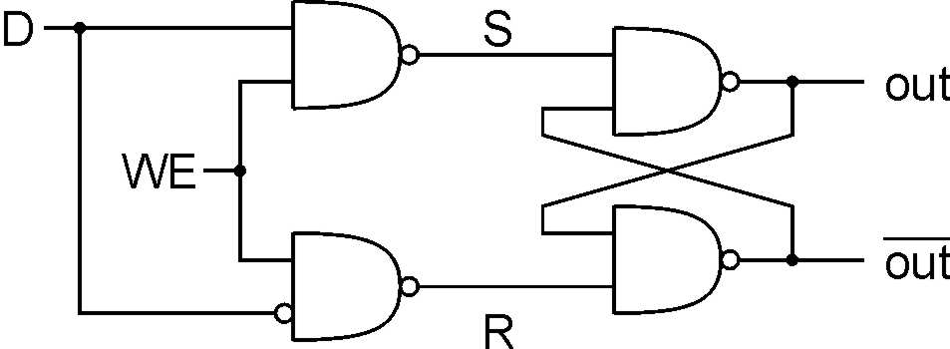
Gated D-Latch
Two inputs: D (data) and WE (write enable)
when WE = 1, latch is set to value of D
S = NOT(D), R = D
when WE = 0, latch holds previous value
S = R = 1
Notes:
The D-latch is used to store a single data bit. The latch is set to the value of D whenever WE=1; when WE=0, the current value is stored, no matter what D becomes.
Using D and not(D) to control S and R makes it easier to ensure that S and R are never zero at the same time.
WE allows us to control when a new value is written to the latch.

Slide 30
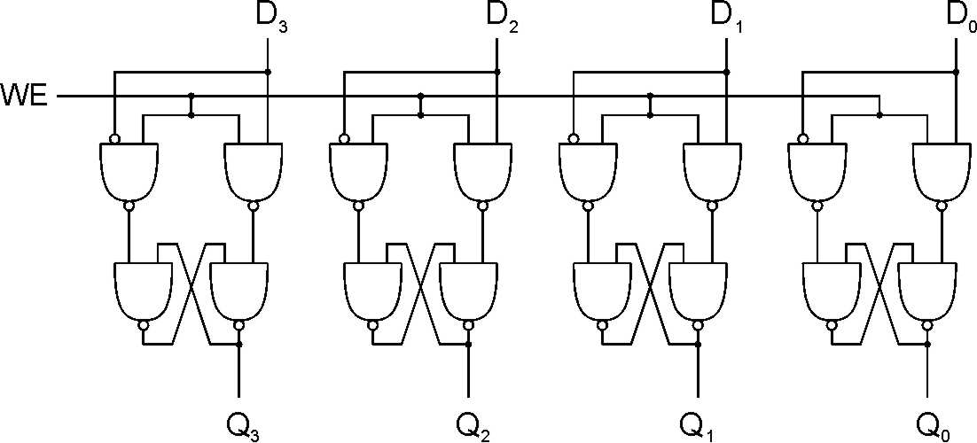
Register
A register stores a multi-bit value.
We use a collection of D-latches, all controlled by a common WE.
When WE=1, n-bit value D is written to register.

Slide 31
Memory
Now that we know how to store bits, we can build a memory – a logical k × m array of stored bits.
Address Space:
number of locations (usually a power of 2)
k = 2^{n}
locations
•
•
•
Addressability:
number of bits per location (e.g., byte-addressable)
m bits

Slide 32
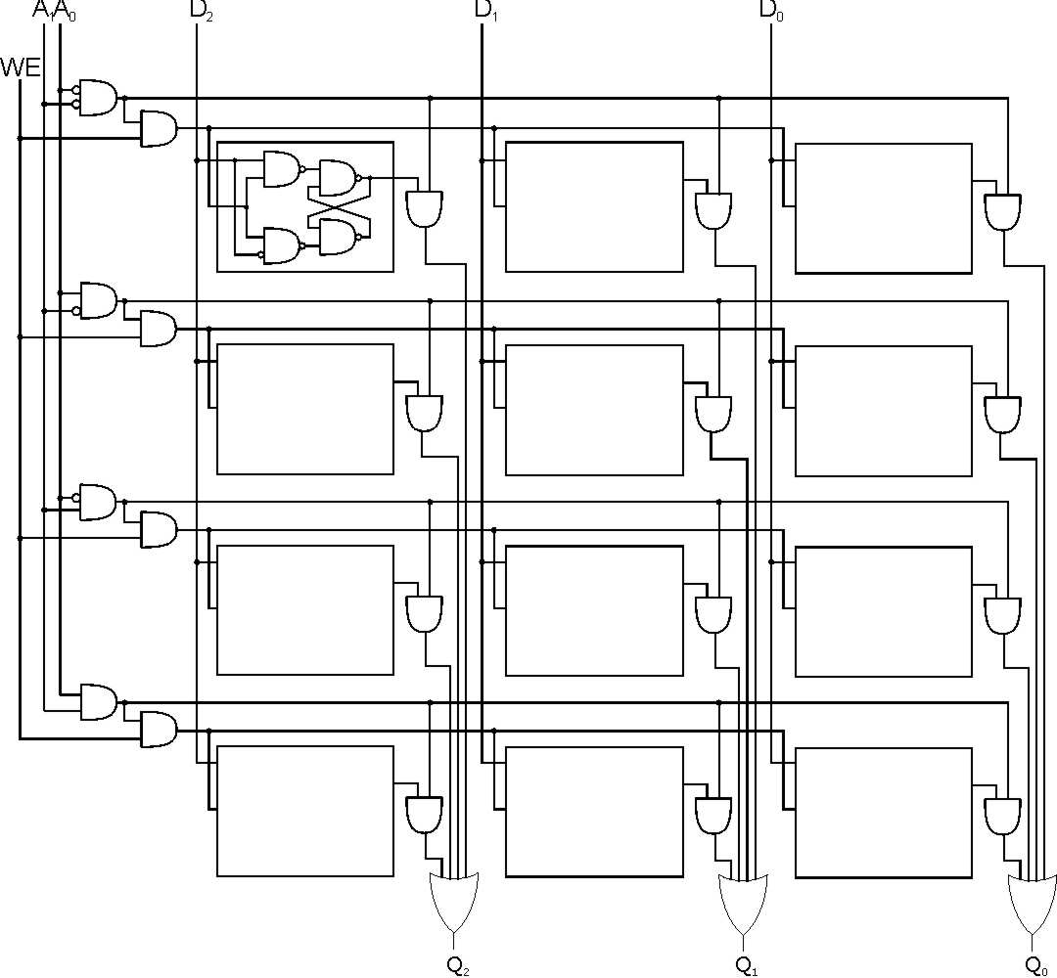
2² x 3 Memory
word select
word WE
input bits
address
write
enable
address
decoder
output bits
Notes:
Decoder asserts one of the word select lines, based on address.
Word select activates one of the output AND gates, which drives the selected data to the output OR gate. (For a read, this is basically a MUX -- decoder ANDed with signals, results ORed together.)
When writing, the only WE bits for the proper word are asserted (based on decoder again).

Slide 33
More Memory Details
This is a not the way actual memory is implemented.
fewer transistors, much more dense, relies on electrical properties
But the logical structure is very similar.
address decoder
word select line
word write enable
Two basic kinds of RAM (Random Access Memory)
Static RAM (SRAM)
fast, maintains data as long as power applied
Dynamic RAM (DRAM)
slower but denser, bit storage decays – must be periodically refreshed
Also, non-volatile memories: ROM, PROM, flash, …

Slide 34
State Machine
Another type of sequential circuit
Combines combinational logic with storage
“Remembers” state, and changes output (and state) based on inputs and current state
State Machine
Inputs
Combinational
Logic Circuit
Outputs
Storage
Elements

Slide 35
Combinational vs. Sequential
Two types of “combination” locks
30
4
1
8
4
25
5
20
10
15
Combinational
Success depends only on the values, not the order in which they are set.
Sequential
Success depends on the sequence of values
(e.g, R-13, L-22, R-3).

Slide 36
State
The state of a system is a snapshot of all the relevant elements of the system at the moment the snapshot is taken.
Examples:
The state of a basketball game can be represented by the scoreboard.
Number of points, time remaining, possession, etc.
The state of a tic-tac-toe game can be represented by the placement of X’s and O’s on the board.

Slide 37
State of Sequential Lock
Our lock example has four different states, labelled A-D: A: The lock is not open, and no relevant operations have been performed.
B: The lock is not open, and the user has completed the R-13 operation.
C: The lock is not open, and the user has completed R-13, followed by L-22.
D: The lock is open.

Slide 38
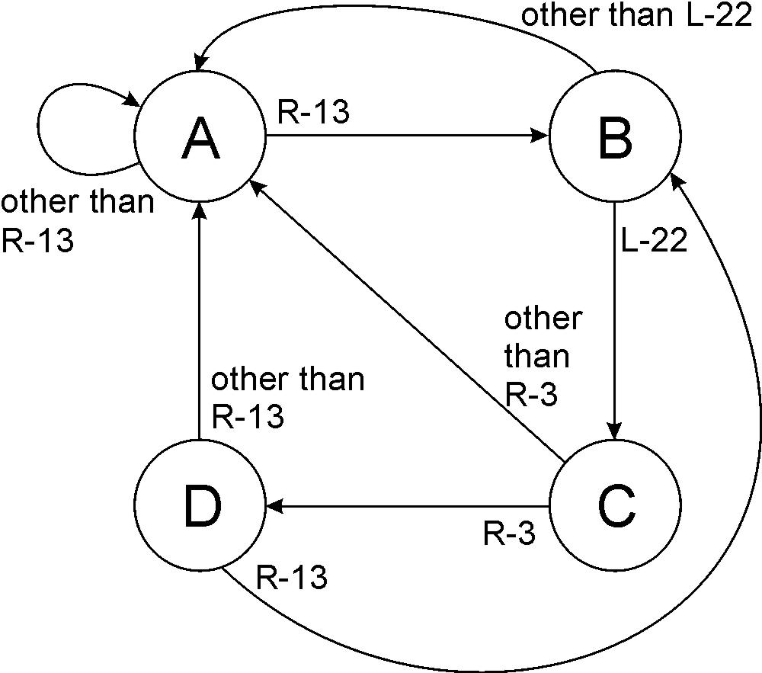
State Diagram
Shows states and actions that cause a transition between states.

Slide 39
Finite State Machine
A description of a system with the following components:
A finite number of states
A finite number of external inputs
A finite number of external outputs
An explicit specification of all state transitions
An explicit specification of what determines each external output value
Often described by a state diagram.
Inputs trigger state transitions.
Outputs are associated with each state (or with each transition).

Slide 40
The Clock
Frequently, a clock circuit triggers transition from one state to the next.
At the beginning of each clock cycle, state machine makes a transition, based on the current state and the external inputs.
Not always required. In lock example, the input itself triggers a transition.
“1”
“0”
One
Cycle
time→

Slide 41
Implementing a Finite State Machine
Combinational logic
Determine outputs and next state.
Storage elements
Maintain state representation.
State Machine
Inputs
Combinational
Logic Circuit
Outputs
Storage
Elements
Clock

Slide 42
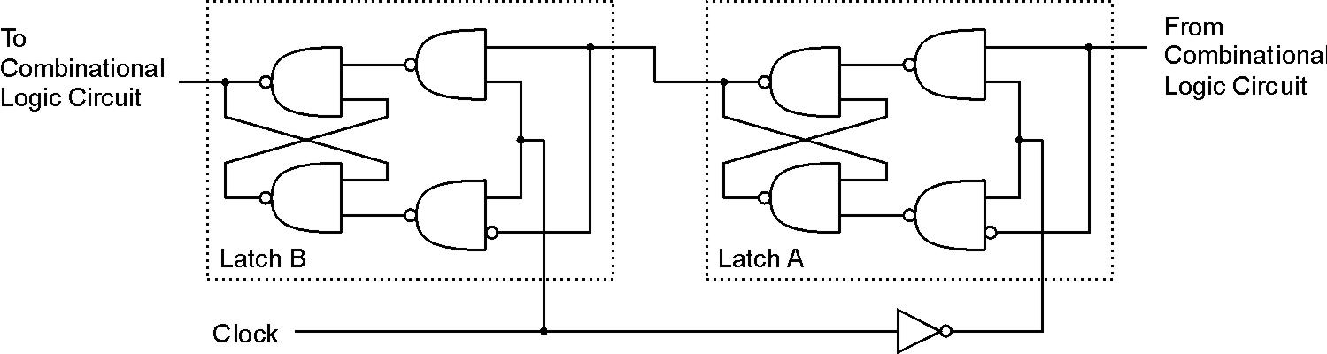
Storage: Master-Slave Flipflop
A pair of gated D-latches, to isolate next state from current state.
During 1st phase (clock=1), previously-computed state becomes current state and is sent to the logic circuit.
During 2nd phase (clock=0), next state, computed by logic circuit, is stored in Latch A.

Slide 43
Storage
Each master-slave flipflop stores one state bit.
The number of storage elements (flipflops) needed is determined by the number of states (and the representation of each state).
Examples:
Sequential lock
Four states – two bits
Basketball scoreboard
7 bits for each score, 5 bits for minutes, 6 bits for seconds, 1 bit for possession arrow, 1 bit for half, …

Slide 44
Complete Example
A blinking traffic sign
No lights on
1 & 2 on
1, 2, 3, & 4 on
1, 2, 3, 4, & 5 on
(repeat as long as switch is turned on)
3
4
1
5
2
DANGER MOVE RIGHT

Slide 45
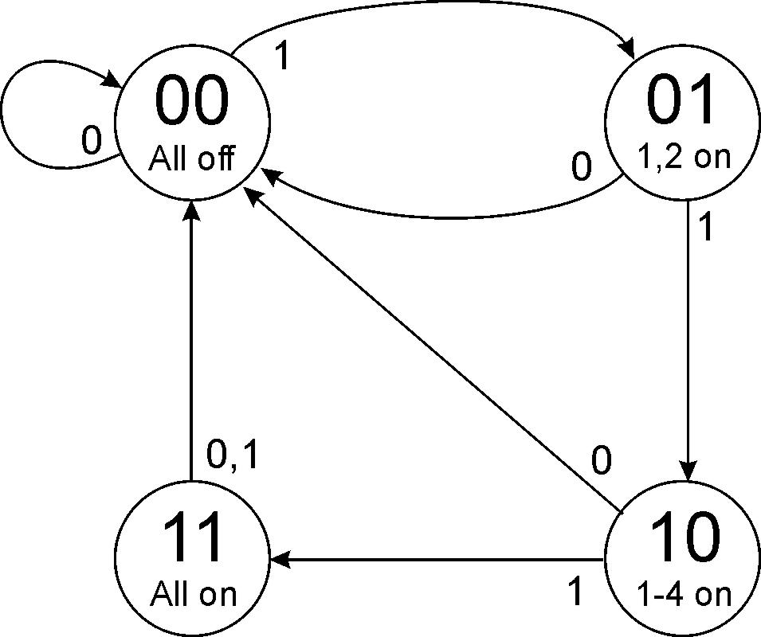
Traffic Sign State Diagram
Switch on
Switch off
State bit S₁
State bit S₀
Outputs
Transition on each clock cycle.

Slide 46
Traffic Sign Truth Tables
Outputs
(depend only on state: S₁S₀)
Next State: S₁’S₀’ (depend on state and input)
Lights 1 and 2
Switch
Lights 3 and 4
In | S₁ | S₀ | S₁’ | S₀’
0 | X | X | 0 | 0
1 | 0 | 0 | 0 | 1
1 | 0 | 1 | 1 | 0
1 | 1 | 0 | 1 | 1
1 | 1 | 1 | 0 | 0
Light 5
S₁ | S₀ | Z | Y | X
0 | 0 | 0 | 0 | 0
0 | 1 | 1 | 0 | 0
1 | 0 | 1 | 1 | 0
1 | 1 | 1 | 1 | 1
Whenever In=0, next state is 00.

Slide 47
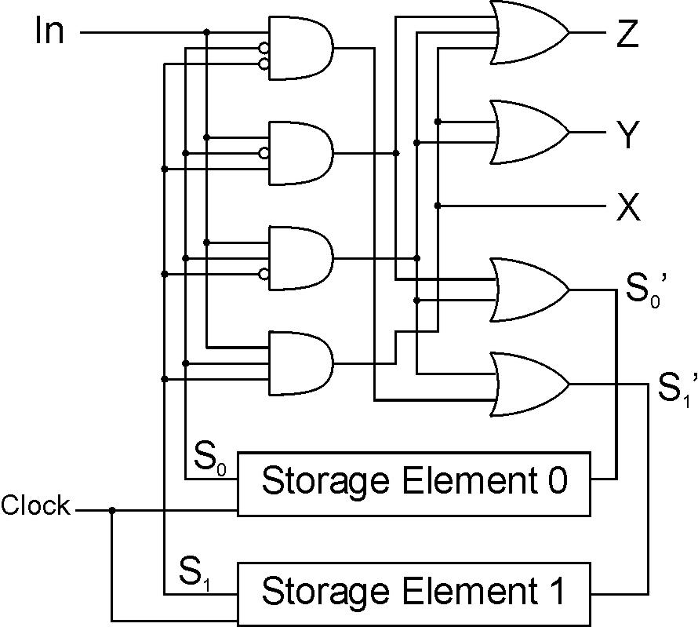
Traffic Sign Logic
Master-slave flipflop

